Slide 1
Compile Principle and Technology

Slide 2
8.4 Code Generation of Control Statements and Logical Expressions
if-statement and while-statement.
Intermediate code generation for control statements involves the generation of labels in manner.

Slide 3
8.4.1 Code Generation for If – and While – Statements
if-stmt → if ( exp ) stmt | if ( exp ) stmt else stmt
while-stmt → while ( exp ) stmt
The chief problem is to translate the structured control features into an “unstructured” equivalent involving jumps, which can be directly implemented.

Slide 4
8.4.1 Code Generation for If – and While – Statements
In each of these arrangements, there are only two kinds of jumps---
  unconditional jumps
  jumps when the condition is false
    the true case is always a “fall-through” case that needs no jump.
It only needs two jump instructions.
  false jumps: if_f, t1, L1, _ (three address)
  fjp L1 (P-code)
  unconditional jumps: goto (three address)
  ujp (P-code)

Slide 5
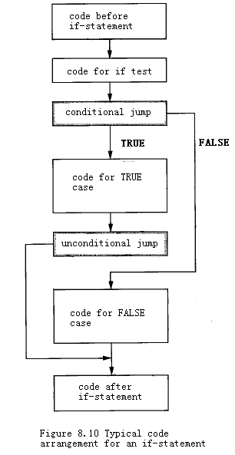

Slide 6
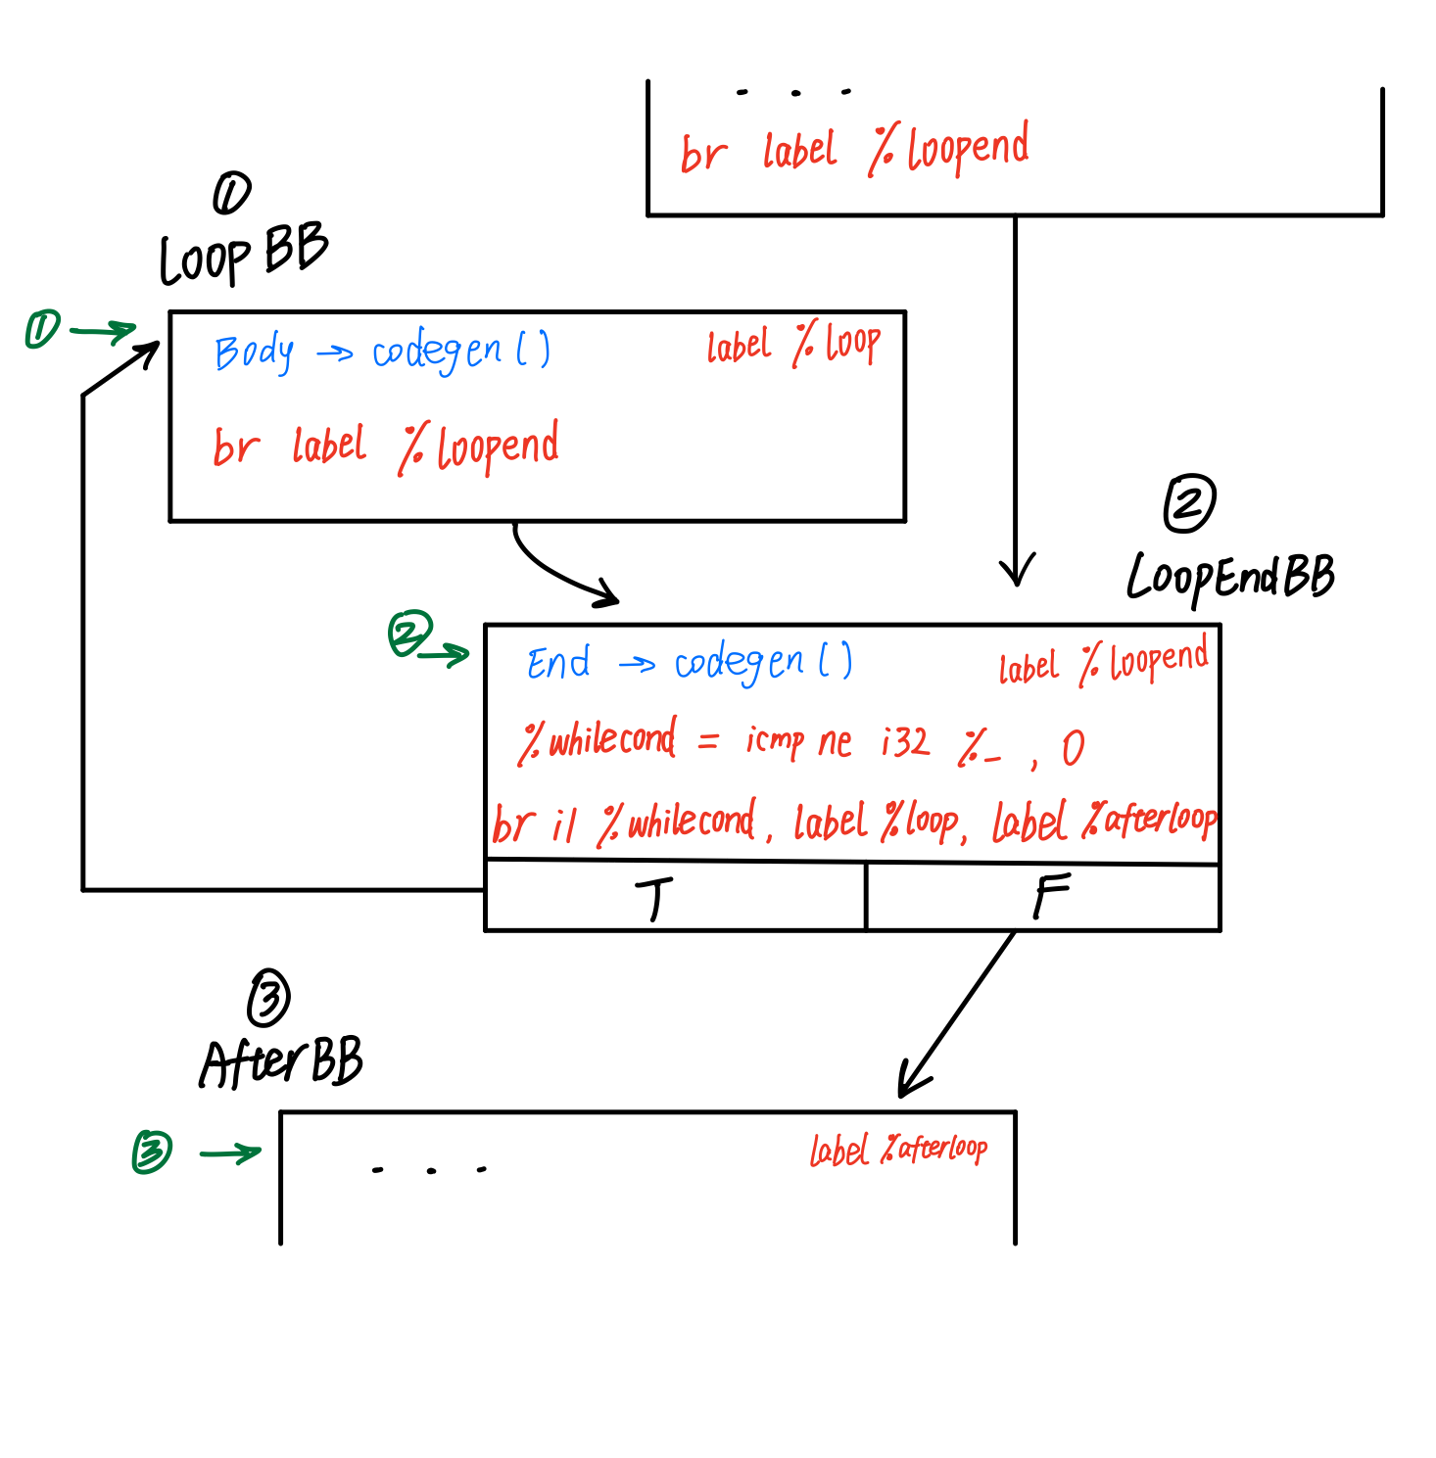
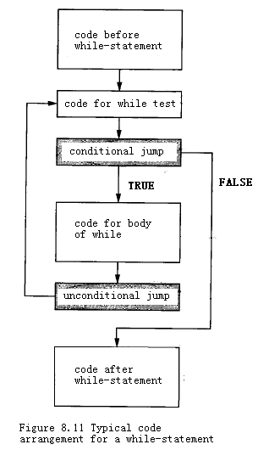
(deprecated

Slide 7
Three-Address Code for Control Statement
if (E) S1 else S2
the following code pattern is generated:
<code to evaluate E to t1>
if_false t1 goto L1
<code for S1>
goto L2
label L1
<code for S2>
label L2

Slide 8
Three-Address Code for Control Statement
while (E) S
  the following code pattern is generated:
  label L1
  <code to evaluate E to t1>
  if_false t1 goto L2
  <code for S>
  goto L1
  label L2

Slide 9
P-Code for Control Statement
for the statement if (E) S1 else S2
The following P-code pattern is generated:
<code to evaluate E>
fjp L1
<code for S1>
ujp L2
lab L1
<code for S2>
lab L2

Slide 10
P-Code for Control Statement
while ( E ) S
the following P-code pattern is generated:
  lab L1
  <code to evaluate E>
  fjp L2
  <code for S>
  ujp L1
  lab L2

Slide 11
8.4.2 Generation of Labels and Backpatching
One feature of code generation for control statements: jumps to a label must be generated prior to the definition of the label itself.
  a standard method for generating such forward jumps :
    leave a gap in the code where the jump is to occur
    generate a dummy jump instruction to a fake location.
when the actual jump location becomes known, this location is used to fix up, or backpatch, the missing code.

Slide 12
8.4.2 Generation of Labels and Backpatching
During the backpatching process a further problem may arise .
  many architectures have two types of jumps.
    a short jump or branch ( within 128 bytes of code)
    a long jump that requires more code space .
a code generator may need to insert nop instructions when shortening jumps, or make several passes to condense the code.

Slide 13
8.4.3 Code Generation of Logical Expressions
The standard way to do this is to represent the Boolean value false as 0 and true as 1.
A further use of jumps is necessary if the logical operations are short circuit.

Slide 14
8.4.3 Code Generation of Logical Expressions
Short-circuit Boolean operators are similar to if-statements, except that they return values.
  a and b ≡ if a then b else a
  a or b ≡ if a then a else b
To generate code that ensures that the second subexpression will be evaluated only when necessary.

Slide 15
8.4.3 Code Generation of Logical Expressions
( x != 0 ) && ( y == x )
lod x
ldc 0
neq
fjp L1
lod y
lod x
equ
ujp L2
lab L1
lod FALSE
lab L2

Slide 16
8.4.4 A Sample code Generation Procedure for If- and While- Statements
stmt → if-stmt | while-stmt | break | other
if-stmt → if ( exp ) stmt | if ( exp ) stmt else stmt
while-stmt → while ( exp ) stmt
exp → true | false

Slide 17
8.4.4 A Sample code Generation Procedure for If- and While- Statements
typedef enum { ExpKind,IfKind, WhileKind, BreakKind, OtherKind } NodeKind;
typedef struct streenode
{ NodeKind kind;
struct streenode * child[3] ;
int val; /* used with ExpKind */
} STreeNode;
typedef STreeNode *SyntaxTree;

Slide 18
8.4.4 A Sample code Generation Procedure for If- and While- Statements
The genlabel procedure that returns label names in the sequence L1,L2,L3, and so on.
The gencode procedure here has an extra label parameter that is needed to generate an absolute jump for a break-statement.
A break-statement will always cause a jump out of the most closely nested while-statement.

Slide 19
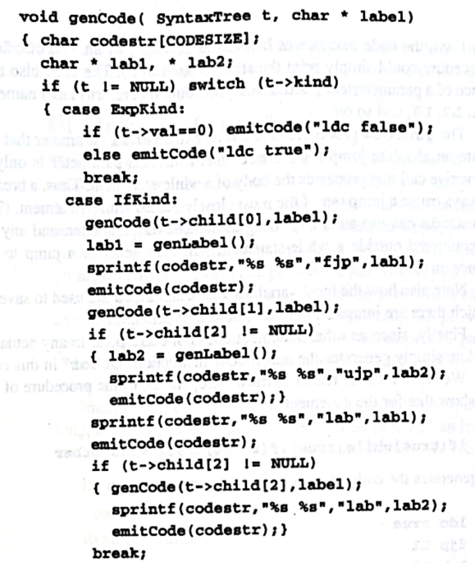
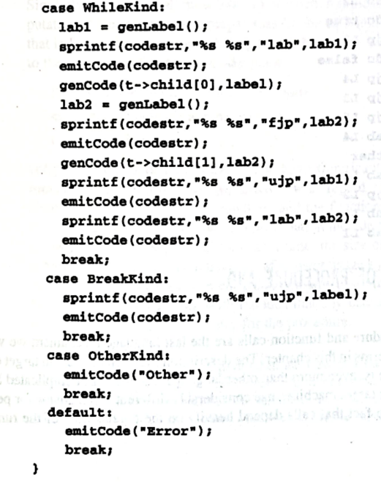
8.4.4 A Sample code Generation Procedure for If- and While- Statements

Slide 20
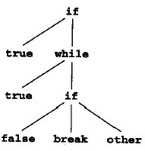
8.4.4 A Sample code Generation Procedure for If- and While- Statements
if (true) while (true) if (false) break else other
it generates the code sequence
  ldc true (if……
  fjp L1
  lab L2 (while……
  ldc true
  fjp L3
  ldc false (if………
  fjp L4
  ujp L3
  ujp L5
  lab L4
  Other
  lab L5
  ujp L2
  lab L3
  lab L1

Slide 21
8.5 Code Generation of Procedure and Function Calls
different target machines use considerably different mechanisms for performing calls and calls depend heavily on the organization of the runtime environment.
It is difficult to achieve an intermediate code representation that is general enough to use for any target architecture or runtime environment.

Slide 22
8.5.1 Intermediate Code for Procedures and Functions
there are actually two mechanisms that need descriptions: function/procedure definition and function/procedure call.
A definition:
  create a function name, parameters, and code
  the function does not execute at that point.
A call :
  create actual values for the parameters
  perform a jump to the code of the function

Slide 23
8.5.1 Intermediate Code for Procedures and Functions
a function call must have:
  an instruction indicating the beginning of the computation of the arguments
  the an actual call instruction
  the actual jump to the code of the function can take place
Begin-argument-computation instruction
<code to compute the arguments >
Call instruction

Slide 24
8.5.1 Intermediate Code for Procedures and Functions
1) Three-Address Code for Procedures and Functions
  int f ( int x, int y )
  { return x + y + 1; }
This will translate into the following three-address code:
  entry f
  t1 = x + y
  t2 = t1 + 1
  return t2

Slide 25
8.5.1 Intermediate Code for Procedures and Functions
three different three-address instructions:
  1. instruction begin_args : signal the start of argument computation ( a zero-address instruction);
  2. an instruction arg : specify the names of argument values ( include the address , or name, of the argument value)
  3. an instruction call : the actual call instruction (call) a one-address instruction (the name or entry point of the function being called must be given) .

Slide 26
8.5.1 Intermediate Code for Procedures and Functions
call f (2+3, 4)
translates to the three-address code
  begin_args
  t1 = 2 + 3
  arg t1
  arg 4
  call f

Slide 27
8.5.1 Intermediate Code for Procedures and Functions
2) P_code for Procedures and functions
  ent f
  lod x
  lod y
  adi
  ldc 1
  adi
  ret ; *sp is return value
  int f ( int x, int y )
  { return x + y + 1; }

Slide 28
8.5.1 Intermediate Code for Procedures and Functions
the P-code instructions for a call : the mst instruction , the cup instruction.
mst instruction
stands for “mark stack” and corresponds to
the begins_args.
cup instruction:
is the “call user procedure” instruction and corresponds directly to the call instruction of three-address code.

Slide 29
8.5.1 Intermediate Code for Procedures and Functions
call f (2+3, 4)
translates to the P code
  mst
  ldc 2
  ldc 3
  adi
  ldc 4
  cup f
参数入栈顺序与 C 相反

Slide 30
8.5.2 A Code Generation Procedure for Function Definition and Call
program → decl-list exp
decl-list → decl-list decl | ε
decl → fn id ( param-list ) = exp
param-list → param-list, id | id
exp → exp + exp | call | num | id
call → id ( arg-list )
arg-list → arg-list, exp | exp

Slide 31
8.5.2 A Code Generation Procedure for Function Definition and Call
typedef enum
{PrgK, FnK, ParamK, PlusK, CallK, ConstK, IdK}
NodeKind ;
typedef struct streenode
{ NodeKind kind;
struct streenode * lchild, * rchild, * sibling ;
char * name; /* used with
FnK,ParamK,Callk,IdK */
int val; /* used with ConstK */
} StreeNode;
typedef StreeNode * SyntaxTree;

Slide 32
8.5.2 A Code Generation Procedure for Function Definition and Call
Each syntax tree has a root that is a PrgK node. This node is used simply to bind the declarations and the expression of the program together.
  The left child of this node is a silbing list of FnK nodes.
  The right child is the associated program expression.
Each FnK node has a left child that is a sibling list of ParamK nodes.
A CallK node contains the name of the called function and has a right child that is a sibling list of the argument expressions.

Slide 33
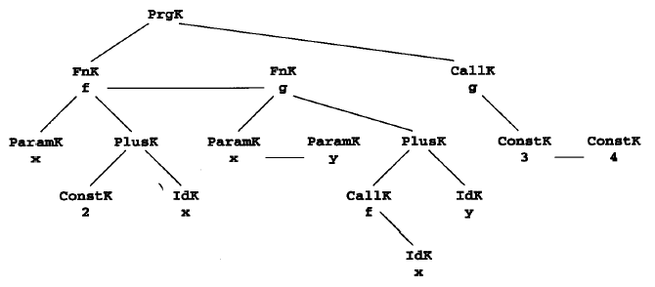
8.5.2 A Code Generation Procedure for Function Definition and Call
ent f
ldc 2
lod x
adi
ret
ent g
mst
lod x
cup f
lod y
adi
ret
mst
ldc 3
ldc 4
cup g
fn f(x) = 2+x
fn g(x,y) = f(x)+y
g(3,4)

